Slide 1
Statistical Computing in MATLAB

Slide 2
Introduction to MatLab
The name MATLAB stands for matrix laboratory
Typical uses include:
Math and computation
Algorithm development
Data acquisition
Modeling, simulation, and prototyping
Data analysis, exploration, and visualization
Scientific and engineering graphics
Application development, including graphical user interface building.
We will be learning how to use MATLAB in Statistics.

Slide 3
DESKTOP TOOLS AND DEVELOPMENT ENVIRONMENT
Workspace Browser – View and make changes to the contents of the workspace.
Command Windows – Run MATLAB statements (commands).
M-file Editor – Creating, Editing, Debugging and Running Files.

Slide 4
MATRICES AND ARRAYS
In MATLAB, a matrix is a rectangular array of numbers. Special meaning is sometimes attached to 1-by-1 matrices, which are scalars, and to matrices with only one row or column, which are vectors.
Where other programming languages work with numbers one at a time, MATLAB allows you to work with entire matrices quickly and easily.

Slide 5
Entering Matrices
A few basic conventions:
Separate the elements of a row with blanks or commas.
Use a semicolon, ; , to indicate the end of each row.
Surround the entire list of elements with square brackets, [ ].

Slide 6
Some Matrix Functions
Sum, transpose and diagonal
sum(A) A’ diag(A)
Subscripts:
The element in row I and column j of A is denoted by A(i,j).
T = A(4,5)
A(4,6)=T
The Colon Operator:
1:10 is a row vector containing the integers from 1 to 10.
To obtain nounit spacing, specify an increment.
For example, 100:-7:50
Subscript expressions involving colons refer to portions of a matrix:
For example, A(1:k,j) is the first k elements of the jth column of A.

Slide 7
Some Matrix Functions (continued)
Generating Matrices Functions :
Build-in functions that create square matrices of almost any size:
magic(4) zeros(4,4) ones(4,4)
rand(4,4) randn(4,4)
Concatenating Matrices:
B=[A A+32; A+48 A+16]
Deleting rows or columns:
X=A
X(:,2)=[]

Slide 8
Expression
Variables
MATLAB does not require any type declarations or dimension statements. When MATLAB encounters a new variable name, it automatically creates the variable and allocates the appropriate amount of storage.
For example:
New_student = 25
To view the matrix assigned to any variable, simply enter the variable name.

Slide 9
Expression (continued)
Numbers
MATLAB uses conventional decimal notation, with an optional decimal point and leading plus or minus sign, for numbers. Scientific notation uses the letter e to specify a power-of-ten scale factor. Imaginary numbers use either i or j as a suffix.
Some examples of legal numbers are
3 -99 0.00019.6397238 1.60210e20
6.02252e231i -3.14159j 3e5i

Slide 10
Expression (continued)
Operators
+ - * / ^
Functions
MATLAB provides a large number of standard elementary mathematical functions, including abs, sqrt, exp, and sin. For a list of the elementary mathematical functions, type :
help elfun
For a list of more advanced mathematical and matrix functions, type:
help specfun
help elmat

Slide 11
Linear Algebra:
Examples:
A+A’
A*A’
D=det(A)
R=rref(A) % reduced row echelon form of A
X=inv(A)
E=eig(A)
Ploy(A) % coefficients in the characteristics equation

Slide 12
Arrays:
+ | Addition
- | Subtraction
.* | Element-by-element multiplication
./ | Element-by-element division
.\ | Element-by-element left division
.^ | Element-by-element power
.' | Unconjugated array transpose

Slide 13
Multivariate Data:
MATLAB uses column-oriented analysis for multivariate statistical data. Each column in a data set represents a variable and each row an observation. The (i,j)th element is the ith observation of the jth variable.
As an example, consider a data set with three variables:
Heart rate
Weight
Hours of exercise per week

Slide 14
Flow control:
if, else, and else if
if rem(n,2) ~= 0
M = odd_magic(n)
elseif rem(n,4) ~= 0
M = single_even_magic(n)
else
M = double_even_magic(n)
end
switch and case
switch (rem(n,4)==0) + (rem(n,2)==0)
case 0 M = odd_magic(n)
case 1 M single_even_magic(n)
case 2 M = double_even_magic(n)
otherwise error('This is impossible') end

Slide 15
Flow Control (continued)
For
for i = 1:m
for j = 1:n
H(i,j) = 1/(i+j);
end
end
while
a = 0; fa = -Inf;
b = 3; fb = Inf;
while b-a > eps*b
x = (a+b)/2;
fx = x^3-2*x-5;
if sign(fx) == sign(fa)
a = x; fa = fx;
else
b = x; fb = fx;
end
end
x

Slide 16
Graphics
Basic Plotting
x = 0:pi/100:2*pi;
y = sin(x);
plot(x,y)
xlabel('x = 0:2\pi')
ylabel('Sine of x')
title('Plot of the Sine Function','FontSize',12)

Slide 17
DATA ANALYSIS AND STATISTICS

Slide 18
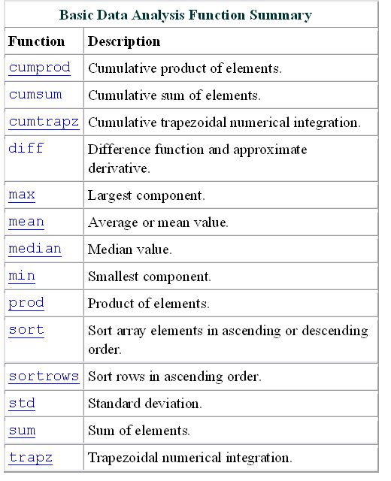
Basic Data Analysis
Import data set
Scatter plot

Slide 19
Basic Data Analysis (continued)
Covariance and Correlation
Example
Covariance and Correlation Coefficient Function Summary
Function | Description
cov | Variance of vector - measure of spread or dispersion of sample variable. Covariance of matrix - measure of strength of linear relationships between variables.
corrcoef | Correlation coefficient - normalized measure of linear relationship strength between variables.

Slide 20
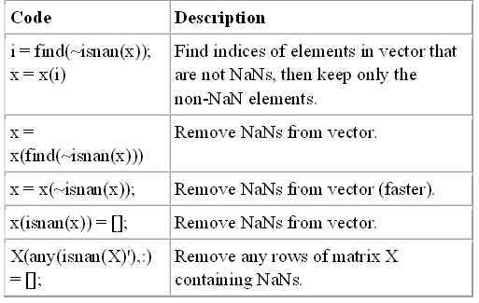
Preprocessing
Missing Values
You should remove NaN (The special value, NaN, stands for Not-a-Number in MATLAB)s from the data before performing statistical computations.

Slide 21
Preprocessing (continued)
Removing Outliers
You can remove outliers or misplaced data points from a data set in much the same manner as NaNs.
Calculate the mean and standard deviation from the data set.
Get the column of points that lies outside the 3*std.
Remove these points
Example

Slide 22
Regression and Curve Fitting
You can find these coefficients efficiently by using the MATLAB backslash operator.
Example: Ordinary least squares
y=b₀+b₁x
Polynomial Regression
Example:
Linear-in-the-Parameters Regression
Example:
Multiple Regression
Example:

Slide 23
Thank you !

